Slide 1


Predicting European Weather with Machine Learning
Final Proposal for ClimateWins
Paul Maden
June 2025
Image Credit: Depositphotos
Notes:
- Welcome and brief intro
- My name is Paul Maden
- This is my final proposal for ClimateWins
- Focus: using machine learning to predict climate trends and identify safe regions in Europe

Slide 2
Objectives & Thought Experiments
Objectives:
1.
Identify weather patterns outside the regional norm
2.
Determine if unusual patterns are increasing
3.
Predict future weather conditions (25–50 years).
4.
Determine safest areas to live in Europe over the next 25 to 50 years
3 Thought Experiments:
1. Discovering Patterns in Changing Weather
What if hidden weather patterns – missed by traditional methods – could reveal early signs of climate shifts?
2. Better Forecasts Through Tuning
What if tweaking model settings (hyperparameters) Could dramatically boost the accuracy of long-term climate forecasts?
3. Seeing Weather with Machine Learning
What if machines could visually read radar-style weather patterns to detect early signs of dangerous change
Goal: Identify early warning signs of changing climate behaviour before they escalate into more extreme or widespread events!
Approach: Use Bayesians optimisation to fine tune a CNN (Convolution Neutral Network) model for predicting future weather patterns
Approach: Unsupervised clustering (e.g. PCA) to group weather patterns
Goal: Build accurate forecasting models - refining how models learn from data
Approach: Train CNN using weather data transformed into radar like visual formats focusing on visual pattern recognition
Goal: Identify extreme weather events early using vision-based ML models
Notes:
- ClimateWins wants to prepare for future weather challenges
- Objectives: find unusual patterns, predict future conditions, identify safe places
- I’ll show 3 thought experiments that each explore different ways ML can help

Slide 3
Machine Learning Options
Unsupervised Learning:
Deep Learning:
Random Forests
GANs (Generative Models)
Use Case: Find hidden patterns in unlabelled data
Example: Discover unusual weather trends over time
Techniques: Clustering (e.g., K-Means), PCA
Value: Highlights changes without needing pre-defined labels
Use Case: Make long-term weather forecasts using past data
Example: Predict rainfall patterns using historical sequences
Techniques: RNNs, LSTMs (with Keras/TensorFlow)
Value: Excellent for modelling complex, time-based climate trends
Example: Predict if tomorrow will be “extreme weather”
Techniques: Decision trees, random sampling
Value: Reliable, interpretable, and performs well on structured data
Use Case: Generate synthetic weather futures
Example: Simulate 2050’s climate under different carbon scenarios
Techniques: Generator + Discriminator networks
Value: Exploratory tool to visualize climate possibilities
Use Case: Classify and predict with robustness and accuracy
Notes:
- Used unsupervised learning, deep learning, and computer vision
- Models include:
a. Clustering (Ward method)
b. CNNs (for radar image recognition)
c. Hyperparameter tuning (to improve accuracy)
- Goal: test what gives the best balance of insight, accuracy, and practical use

Slide 4
Additional Data Needed
Extreme Weather Data
What: Historical records of storms, heatwaves, cold-snaps, floods etc.
Why: Detects patterns of increasing anomalies or regional instability.
Radar & Satellite Imagery
What: Thermal maps, flood zones, urban heat signatures.
Healthcare & Impact Data
What: Weather-related injuries, deaths, or illness concerns.
Geospatial & Infrastructure Maps
What: Elevation, sea-level rise models, migration zones, city layouts
Why: Identifies safe vs vulnerable zones for future population planning
Why: Helps visualise regional risk and enhances model accuracy.
Why: Links climate events to real human costs, for risk models.
Notes:
- Historical weather alone isn’t enough
- Also need:
- Extreme Weather Data
- Radar/satellite images
- Health and population data
- High-resolution climate inputs
- Helps improve model realism and real-world relevance

Slide 5
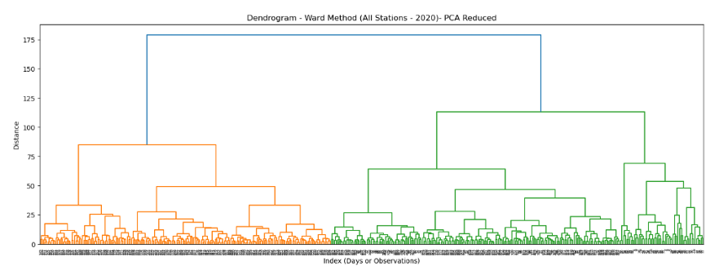
Thought Experiment 1: Discovering Patterns in Changing Weather
Next Steps:
The Future:
For future projects, use the results to support long-term planning and liveability scoring.
Extend this method to multiple years (e.g. 2010-2020) to track changes.
Compare clusters to ‘extreme events’ to validate their meaning
Hypothesis
By using hierarchical clustering, we can detect early signs of climate instability by grouping similar weather patterns across Europe.
Objective
To discover whether unusual or emerging behaviours are already taking place by analysing data from European weather stations.
Approach
Use hierarchical clustering to standardise weather data across Europe.
To make it easier to find clear groups, apply Principal Component Analysis (PCA) to reduce the number of features.
Results
The Ward method consistently produced 3 distinct groups, which aligned with known climate zones like alpine, coastal, continental.
This method gave the best balance between fast processing and meaningful results
Insights
Climate wins should focus on using the Ward method with the scaled and PCA-reduced data, as this gave the best balance between fast processing and meaningful results.
Notes:
- What if subtle climate changes are already visible in daily data?
- Used clustering to find hidden groups in 2020 weather
- PCA reduced data noise, Ward method gave best clarity
- Goal: detect early signs of instability in weather trends

Slide 6
Thought Experiment 2: Better Forecasts Through Tuning
Next Steps:
The Future:
For future projects, use the results to guide early alerts and policy planning across vunerable regions
Expand optimisation to more locations and decades.
Combine tuned models to handle both local patterns and long-term weather shifts.
Hypothesis
By fine-tuning machine learning models, we can boost accuracy and clearly identify which weather variables most affect the climate predictions.
Objective
To improve model performance and reveal which features (e.g. temperature, pressure, radiation) are the strongest indicators of climate-related risks across European regions.
Approach
Use hyperparameter optimisation and Random Forest and CNN models (e.g. grid search, Bayesian tuning).
Compare model performance before and after tuning, focusing on accuracy and key feature insights.
Results
The accuracy improved significantly across stations:
Insights
Hyperparameter tuning revealed more useful and interpretable results.
Tuning helped spotlight high-impact weather features (e.g. Basel station data, temperature, etc.)
CNN model rose from 20% to 88% after tuning + Random Forest from 98.69% to 99.74%
Certain stations (like Basel) emerged as early warning indictors due to strong feature importance.
Notes:
- What if smarter model tuning could boost prediction power?
- Tuned CNN using Bayesian search
- Accuracy jumped from ~10% to over 60%
- Goal: build accurate, long-term forecasting tools

Slide 7
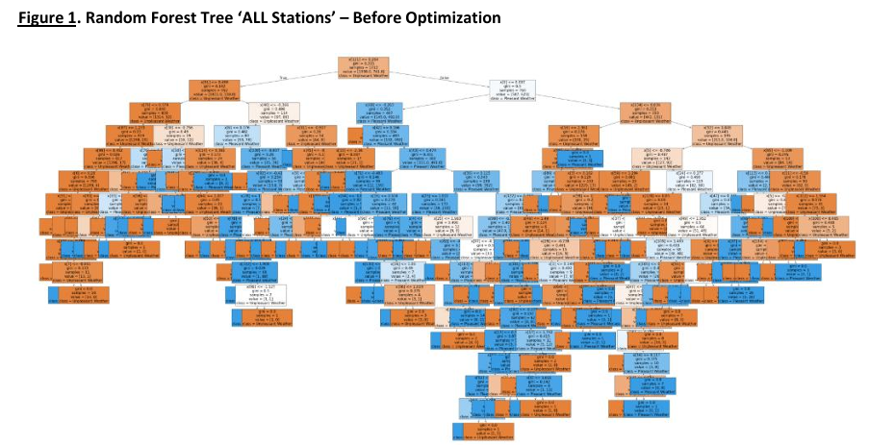
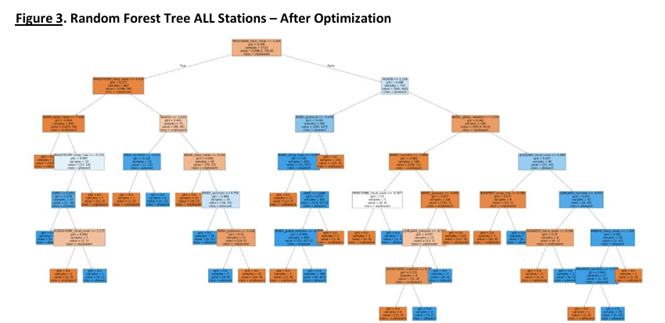
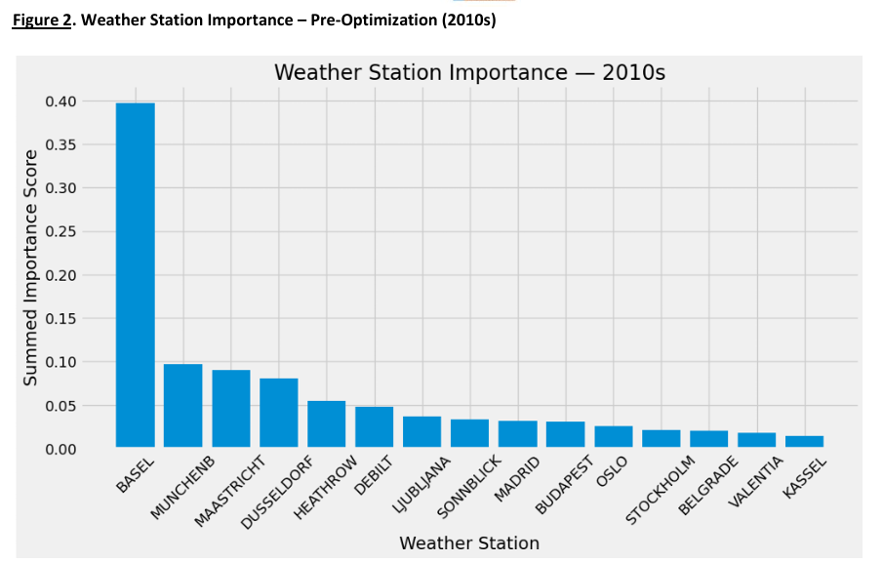
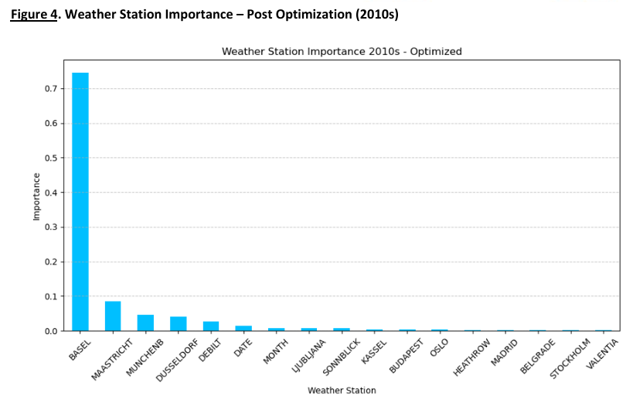
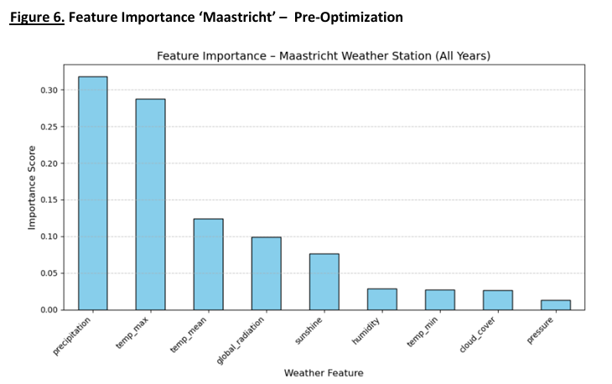
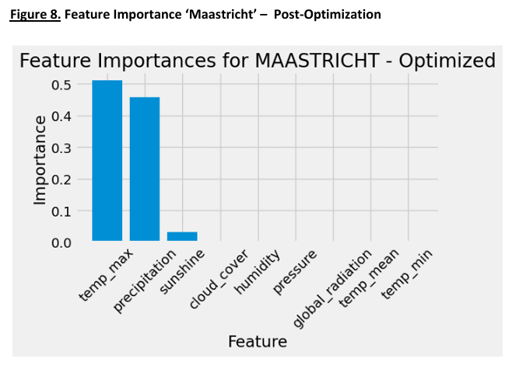
Thought Experiment 2: Better Forecasts Through Tuning (cont..)
Post-Optimised
Pre-Optimised
Notes:
- Left: baseline model before tuning — weak accuracy (e.g. Random Forest)
- Right: optimised model — much higher performance
- Tuning revealed key variables and improved clarity
- Useful for regional or time-based predictions

Slide 8
Thought Experiment 3: Seeing Weather with ML
Next Steps:
The Future:
For future projects, deploy as a visual tool for emergency services or climate dashboards.
Expand image categories (e.g. snow, fog, storms) for broader use.
Combine this with Generative adversarial networks (GANs) to stimulate future radar visuals
Hypothesis
If we train ML to recognise weather from radar images it can support faster, more visual forecasting - especially during extreme events.
Objective
To explore how image-based weather classification can support better real-time predictions, using radar visuals rather than raw data tables.
Approach
Train Convolution Neural Network (CNN) to classify whether images into types (e.g. Cloudy, rain, shine, sunshine).
Results
CNN achieved 93.8% training accuracy & 84.8% validation accuracy after 40 training rounds.
Insights
CNNs can learn to see and classify weather types with high accuracy from basic images.
Use image recognition metrics like accuracy & validation loss to evaluate model success
The model struggled with visually similar types (e.g. cloudy vs shine), but strong overall.
Radar and satellite imagery are rich data sources for machine learning.
Notes:
- What if we let ML see weather changes?
- Trained CNN to classify radar-style images (cloudy, rain, etc.)
- Accuracy hit ~85% with low training error
- Goal: fast visual detection for future risk alerts

Slide 9
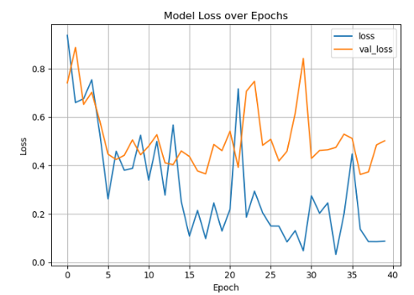
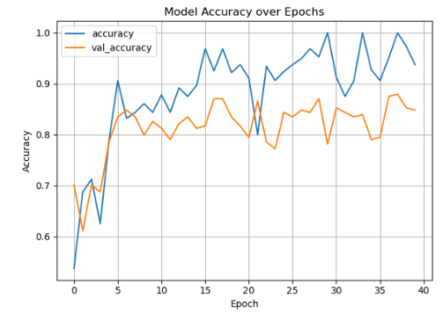
Thought Experiment 3: Seeing Weather with ML (cont..)
CNN Model Error (loss) during training
CNN Model Accuracy during training
Error
At the start both training and validation drop quickly – a sign the model is learning.
The training loss continues to improve but the validation loss fluctuates after about 10 epochs (rounds).
This pattern suggests the model may be starting to overfit the training data slightly (i.e. It’s learning noise, not just patterns).
Accuracy
Accuracy improves quickly in the first few epochs (rounds) - showing strong learning at the start.
The training accuracy continues to rise even reaching nearly 100 percent.
Validation accuracy stays consistently good (~80-88%) but doesn’t rise as much – a sign of overfitting.
Notes:
- Left graph: model loss decreases with training
- Right graph: accuracy improves, but risk of overfitting appears
- Confirms potential for radar-based ML but also highlights need for careful tuning

Slide 10



Summary & Recommendations
Summary of Findings Recommendations Next Steps
Clustering revealed distinct regional weather patterns – Feature analysis over time needed to detect increasing anomalies
Optimising model settings (Hyperparameters) Significantly improved prediction accuracy
Visual machine learning (radar style CNNs) effectively detected extreme weather indicators
Apply CNN radar visual models to support rapid emergency weather response
Incorporate model tuning (Bayesian optimisation) Into future weather forecasting pipelines
Use clustering as an early warning system to monitor emerging climate trends
Test models on wider time ranges (e.g. 2010-2020) to track long term shifts
Validate predictions against real extreme weather records to prove reliability
Combine weather and health/population Data to guide future safe-zone planning
Notes:
Summary of Findings
- ML reveals early signals
- Tuning improves accuracy
- Vision models add a new dimension
Recommendations
- Combine clustering, tuning, and visual ML
- Use GANs to simulate rare events
- Prioritise scalable, interpretable models
Next Steps
- Extend testing to more years
- Validate against real events
- Add population/health data for liveability scoring

Slide 11

Thank You!
These findings can help in identifying safe zones, reduce risk, and support climate-ready communities
Questions?
Contact: wallmaden@hotmail.com
Presented by: Paul Maden
GitHub-Repo: Supervised-ML-Weather-Models
Notes:
Thank you for reviewing the proposal
I’m happy to walk through any deeper technical questions or broader strategic discussions about ClimateWins' future use of machine learning models.
Questions welcome
GitHub repo has code, data, and presentation: Supervised-ML-Weather-Models

